Slide 1


Slide 2

Final Year Project Presentation
On Route Turn and Hurdle Guidance Android App
The University of Lahore Islamabad

Slide 3
Presented By: Muhammad Farjad Ali Raza Supervised By: Mr. Arshad Ali Khan Roll No: SEU-S15-113 Program: BSSE Department :Department Of CS&IT UNIVERSITY OF LAHORE ISLAMABAD CAMPUS

Slide 4
Introduction
The main objective to detect hurdles(speed breaker ,pot holes) and notify the user before reaching near to it speed breakers can cause injury or death.
In India , approx.10,000 deaths per year occur due to speed breakers
Data is collected and saved about the road with separate application.
Client side application take that data and again plot the points collected by training application then after plotting it on map it keeps measuring distance from that point.
When user is at approx. 1000 meter or 500 meter it notify the user.

Slide 5
Objective
Speed kills so do the speed breaker
Avoid road accidents and injuries
Notification of the speed breaker
Location Tracking of the user
Secure
User friendly and informative

Slide 6
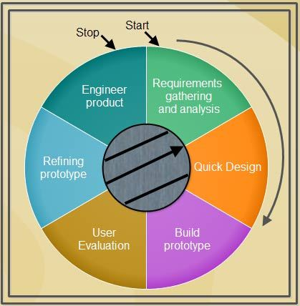
Methodology : Prototyping

Slide 7
Tools and Techniques
Accelerometer reading of z axis
Android Studio
Google Firebase Database
Mapbox and Googlemap Api

Slide 8
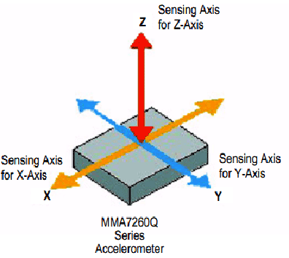

Slide 9

Application Work

Slide 10
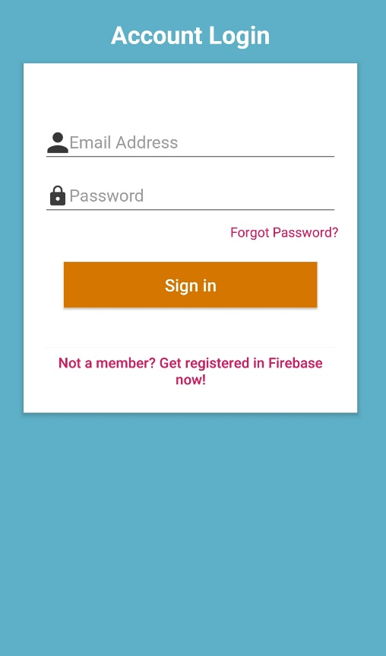
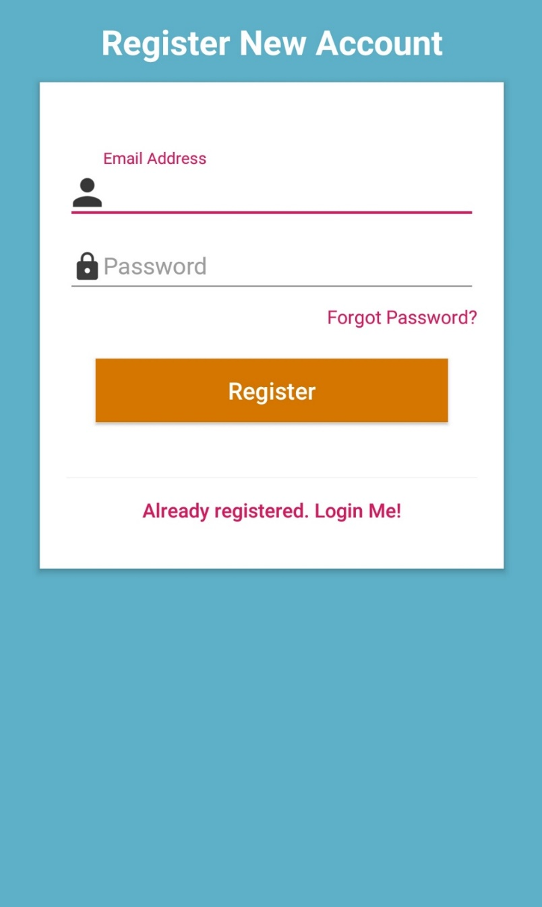
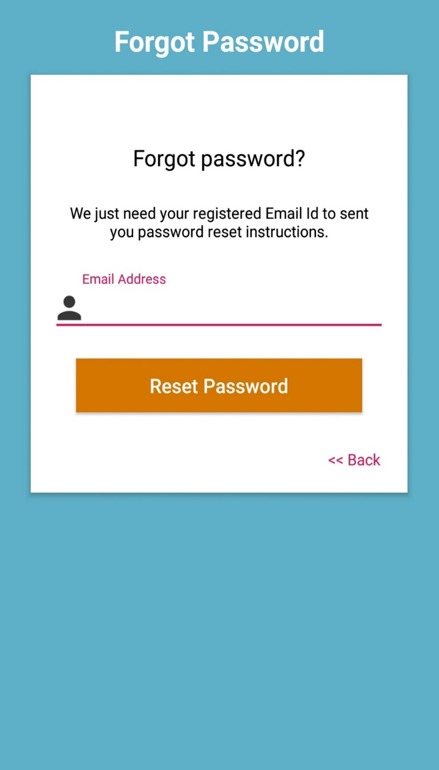
Account Management Activities:

Slide 11
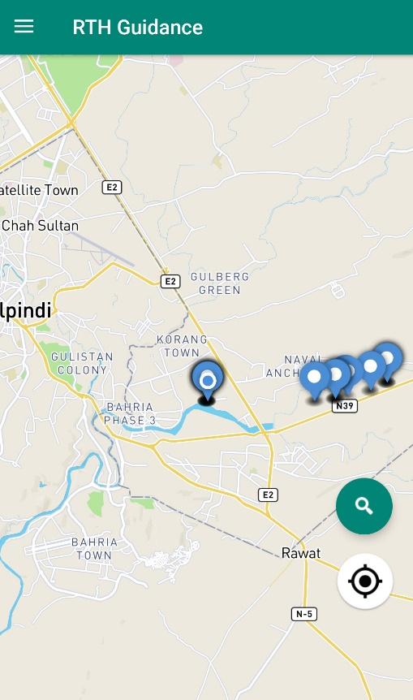
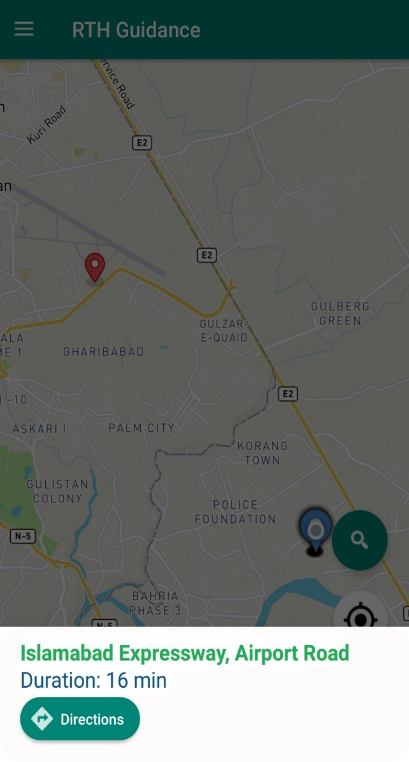
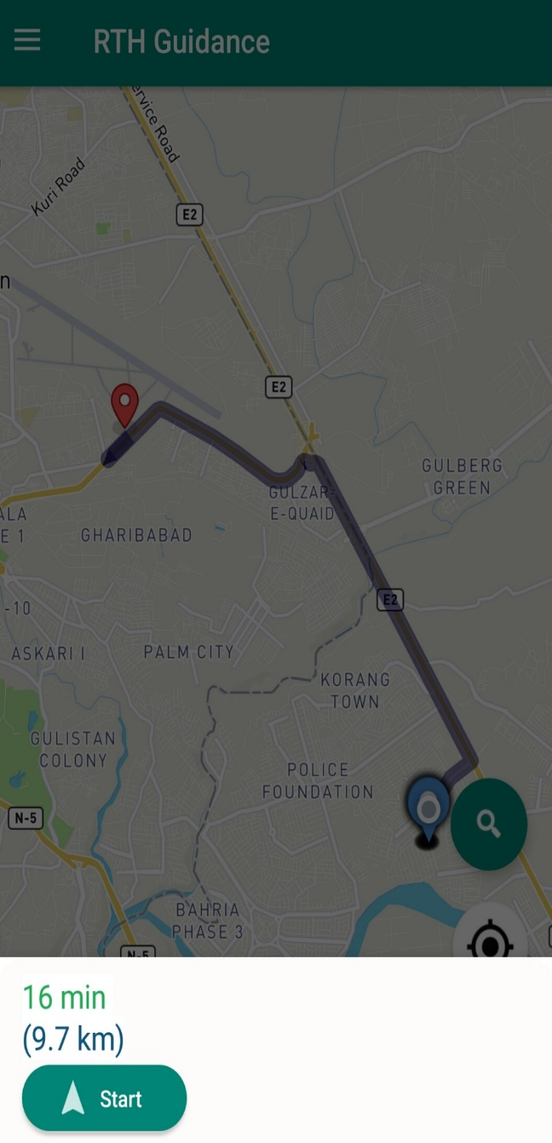
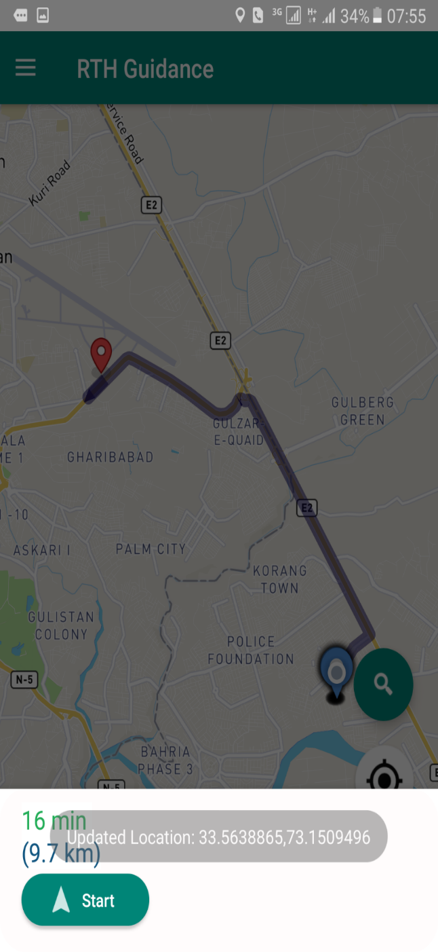
Main Activity:

Slide 12
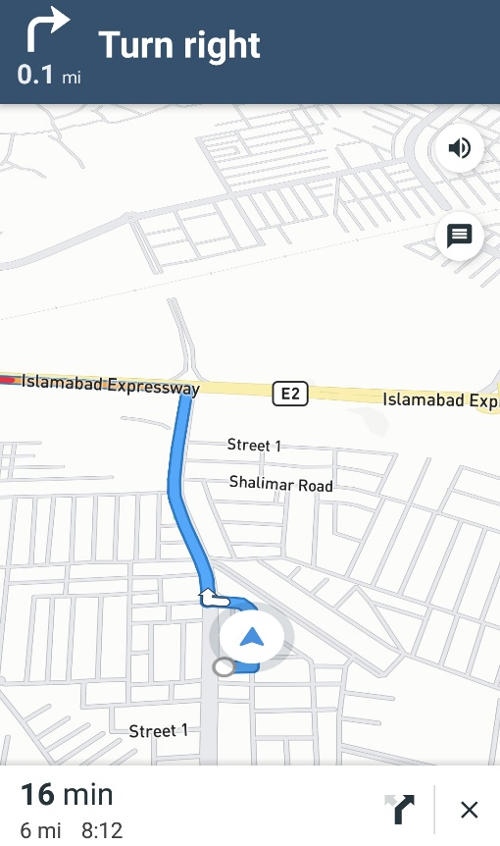
Turn By Turn Navigation:

Slide 13
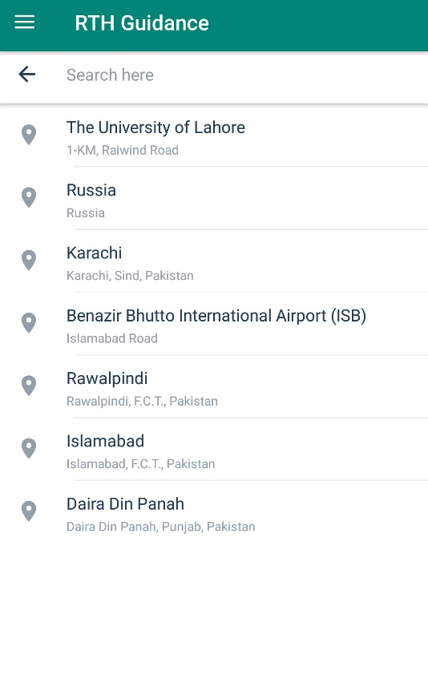
Search:

Slide 14
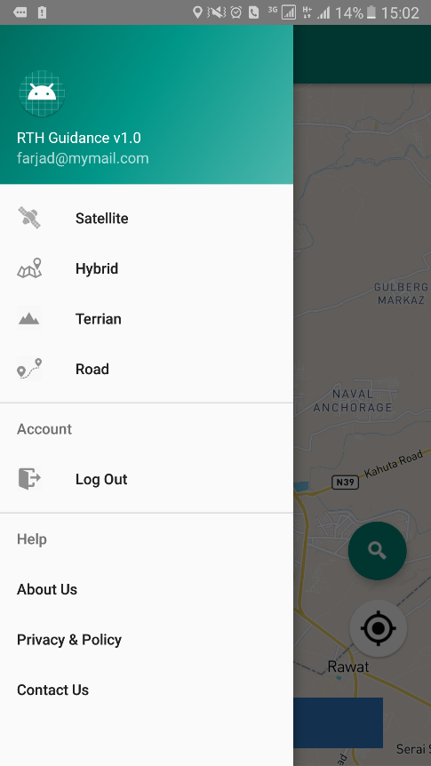
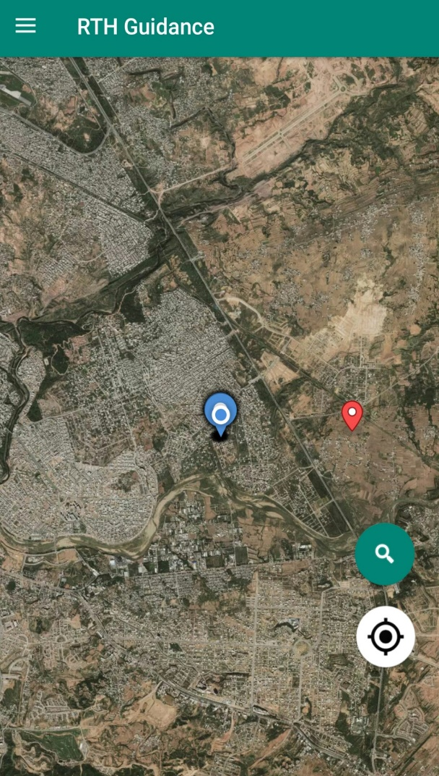
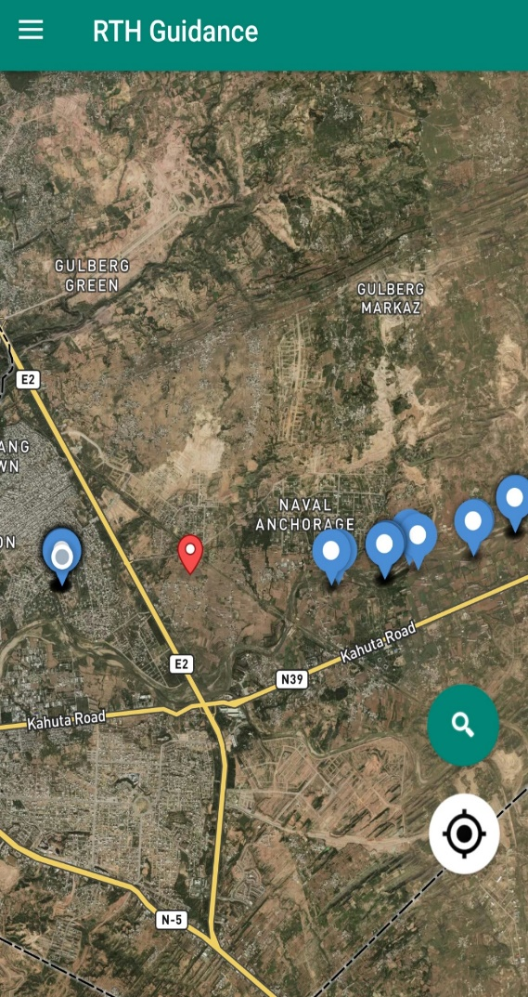
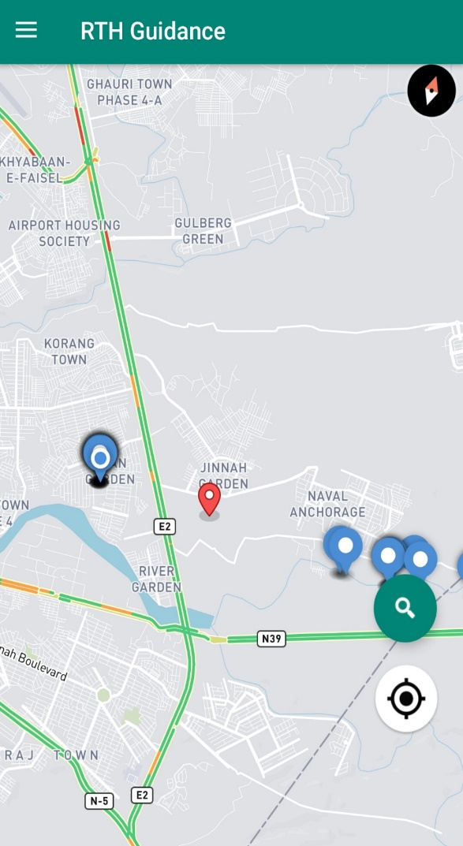
MapStyles:

Slide 15
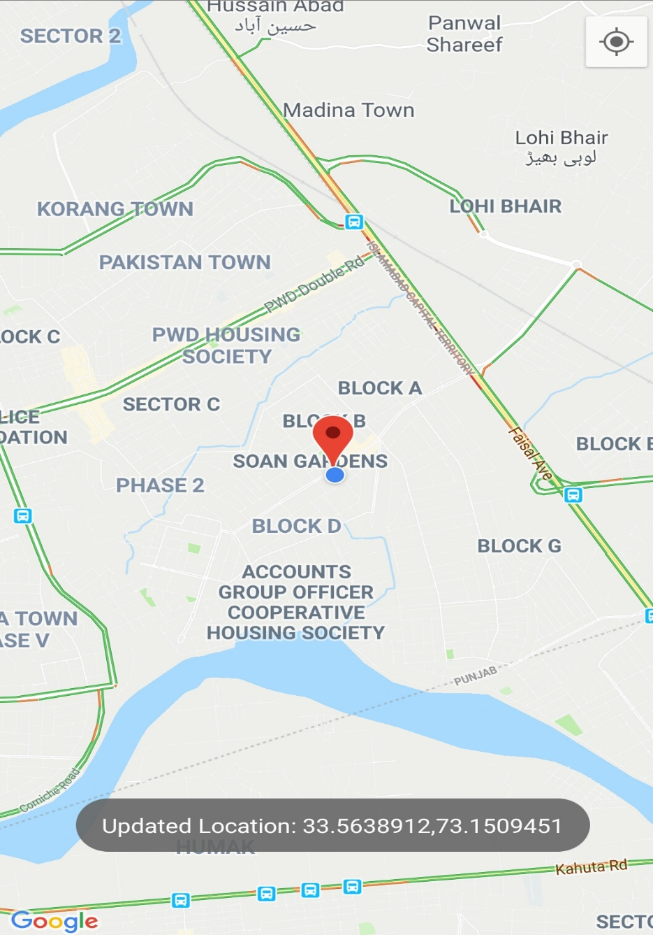
Data Collection App:

Slide 16
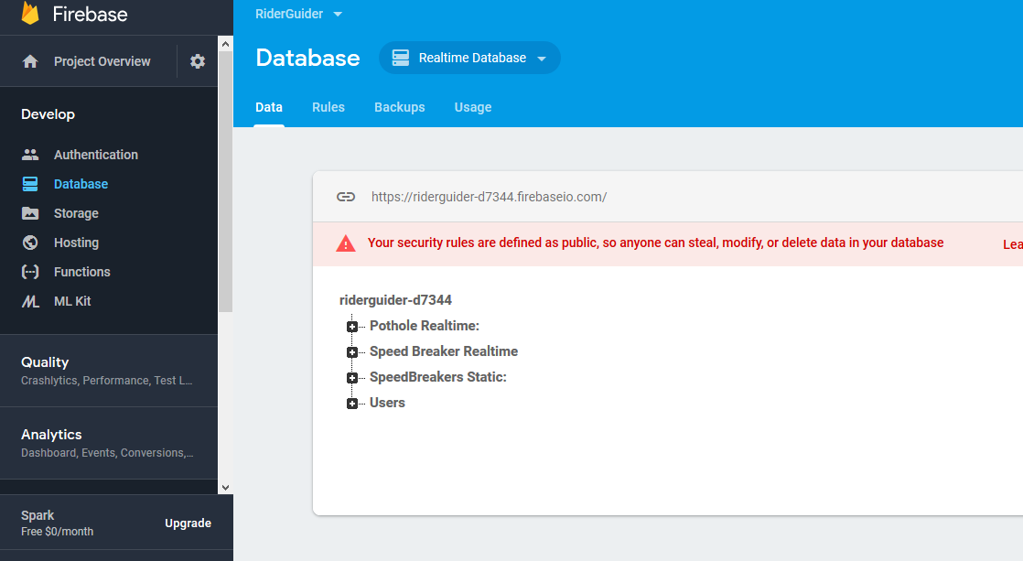
Firebase Data:

Slide 17
Any Questions???

Slide 18
Thank You Very Much !!!!

